Slide 1

CS 46A Project
BY
ZANE MELCHO, JEREMY LOZANO, TIN TRAN

Slide 2
Idea
Write a similar game with all the material of CS 46a based on the classic asteroids game.
…with better interface!

Slide 3
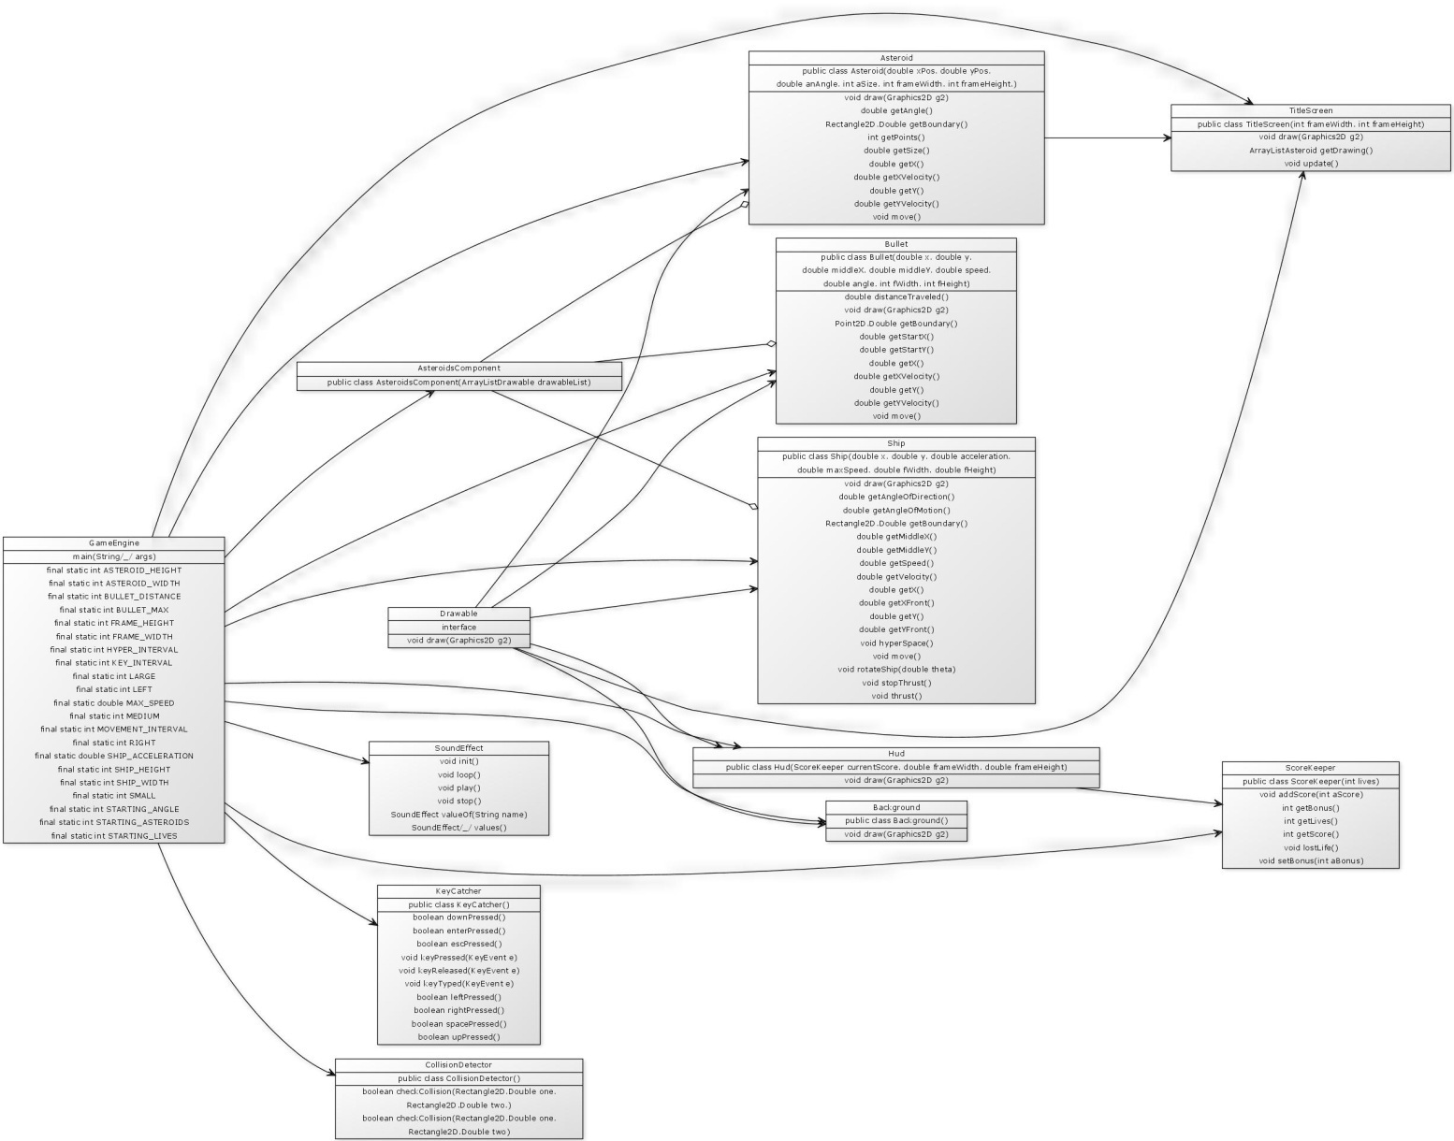
Program structure
http://tinyurl.com/yfepb5l

Slide 4
Diving Tasks
GameEngine , Bullets, Title Screen & HUD, & Sound Effect… (Zane Melcho)
Ship, Score Keeper, & Presentation (Tin Tran)
Asteroids, Asteroids Component, Collision Detector, & Report (Jeremy Lozano)

Slide 5
Concepts and Materials
ArrayList – for controlling the asteroids and the bullets
KeyListener – for controlling each key stroke of the game.
If, else statements – used in all the classes, for rotating the ship, moving the asteroids, firing the bullets and checking for collisions.
Loops (with nested loops) – used in the game engine, for controlling the asteroids, bullets and used in the title screen class.
Importing pictures – for the ships, the asteroids, and the bullet.
Interfaces – for implementing the drawing method for all the classes.
Other concepts (such as boolean, static, random generator…)

Slide 6
Progress
3 weeks
Jeremy : 17 hours
Zane : 22 hours
Tin Tran : 19 hours
3 meetings
Over 60 e-mails

Slide 7
PROBLEMS ENCOUNTERED
Bullets travel slower than the ship.
The distance was not calculated correctly.
Ship did not move or rotate or accelerate when moved.
Asteroids spawning on top of the ship.

Slide 8
What we learned
How to cooperate with each other effectively.
How to divide tasks on a programming project.
More in depth understanding about the material.
How to implement what we learned into some “real world” application.
How to use the Java API more effectively.

Slide 9
DEMONSTRATION

